Slide 1
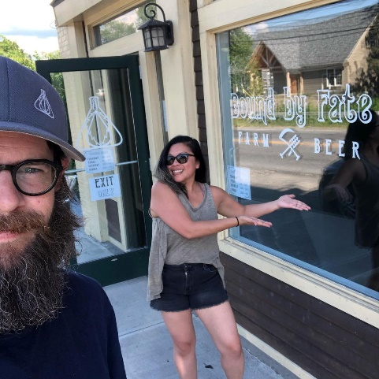
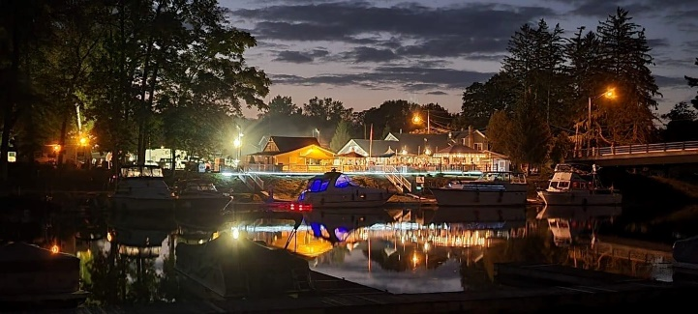
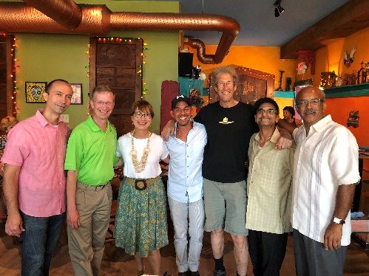
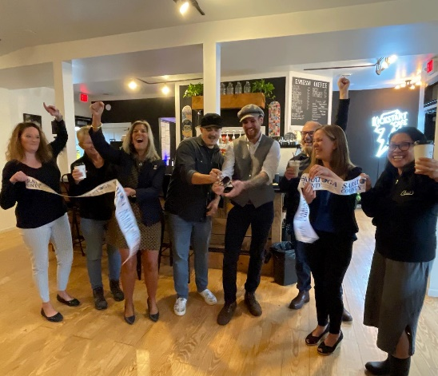
Village of Schuylerville
New York Forward Grant Submission – October 2022
A $4,500,000 NY Forward Grant will incentivize a minimum of $3,624,000,000 in private and public funds to achieve virtually all the stated goal of the NY Forward Program.
In fact, we believe the Village of Schuylerville and it’s 1,408 residents and locally owned business will utilize the NYF funds not just to enhance our Village’s renaissance coming out of the Hudson River dredging, but to position us by 2027 to fully realize the benefits of being the historic site of the Turning Point of the American Revolution 250 years ago, in 1887.

Slide 2
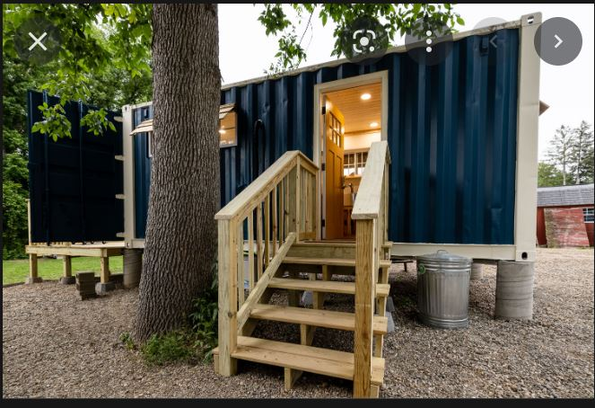
PROJECT #1 | SCHUYLERVILLE MARINA
New York Forward | Village of Schuylerville
Ferry Street Holdings Container Cabins and Special Event Venue
Ferry Street Holdings has invested $2.5 million to upgrade the Schuylerville Marina property to include:
New docks and a houseboat that sleeps six
Restaurant renovations, and the expansion of outdoor dining along the water.
The installation of four container cabins refurbished to accommodate up to two-guest per night per cabin, 180 days of the year.
By May 1, 2023, they’d like NY Forward Funds to help double the number of container cabins on this site at a cost of $100,000.
Community Impact
Where people stay is where they spend their money on vacation. If these units are rented 66% of the time, this would mean nearly 4,000 more guests would stay there and spend money in Schuylerville.
Total Project Cost: $100,000
NYF Requested Amount: $25,000
Site Control Status: Ferry Street Holdings Owns the Property
Additional Funds Identified: $75,000 by Ferry Street Holdings
Project Timeline: May 1, 2023 Operational

Slide 3
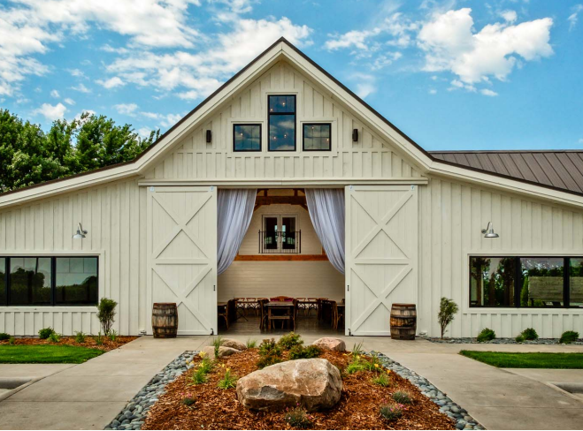
PROJECT #1 CONT. | SCHUYLERVILLE MARINA
New York Forward | Village of Schuylerville
Ferry Street Holdings Container Cabins and Special Event Venue
Continued from first slide:
The barn will be 4,000 sq ft and seat 200 people. We expect to create 25 jobs between food and beverage services & maintenance staff.
By May 1, 2024, we would like NY Forward Funds to assist in making this location the most unique destination in the region for weddings and other events, both private and public/civic. There are islands and there are restored barns in our region, but we know of none that combine the two to create this breath-taking setting right in the middle of the Hudson River.
Community Impact
For private events held at the venue, this brings 200 people into the village. Destination weddings are very popular, and as such these guest need place to stay, eat, explore, and visit. For public and civic events, this is a great way to bring the community together for large gatherings to celebrate an occasion and/or raise awareness for special causes.
Total Project Cost: $800,000
NYF Requested Amount: $264,000
Site Control Status: Ferry Street Holdings Owns the Property
Additional Funds Identified: $536,000 by Ferry Street Holdings
Project Timeline: May 1, 2024 Operational

Slide 4
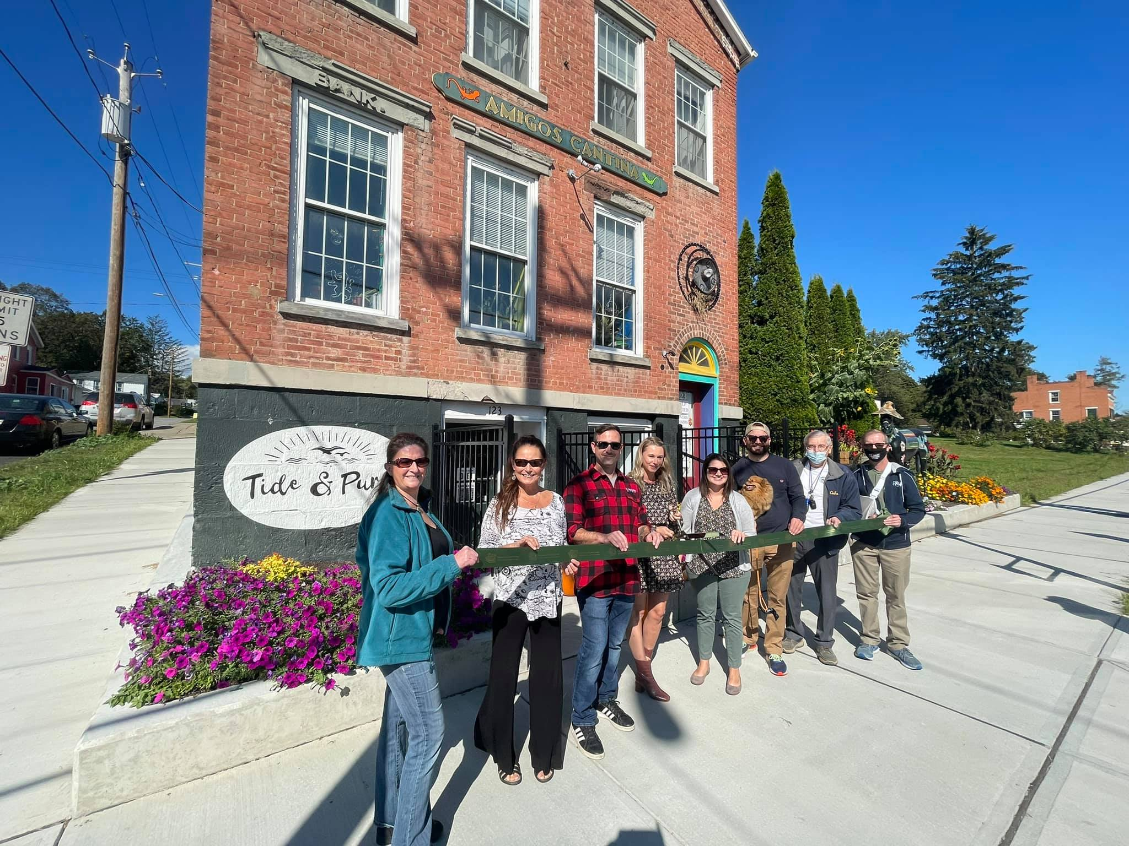
PROJECT #2 | Broad Street New Construction
New York Forward | Village of Schuylerville
Turning Point Development Mixed Use Space
Turning Point Development has invested $450,000 to upgrade 42 Ferry Street and 123 Broad Street and to purchase the vacant property next door which once was the site of a hotel.
42 Ferry Street and 123 Broad Street is a historic building that’s been fully restored.
This property is now home to Amigo’s Cantina, a Mexican restaurant, and Tide & Purl, a women owned retailer.
TPD would like $1.3 Million in NYF funds to construct a $3 million, 18,000 square foot three-story mixed-use building at 128 Broad Street.
Community Impact
There is a need in Schuylerville both for affordable housing and first-floor retail space, and to generate more foot traffic by redeveloping vacant land adjacent to existing commercial space. This project checks all three of these boxes.
Total Project Cost: $3 million
NYF Requested Amount: $1.3 Million
Site Control Status: Turning Point Development owns the Property
Additional Funds Identified: $1.7 million - Turning Point Development
Project Timeline: Completed by spring of 2024

Slide 5
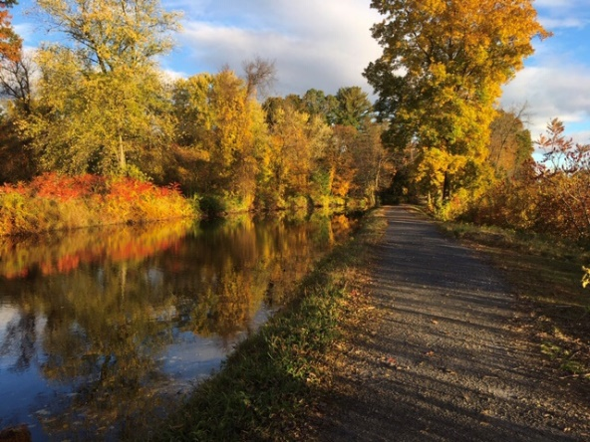
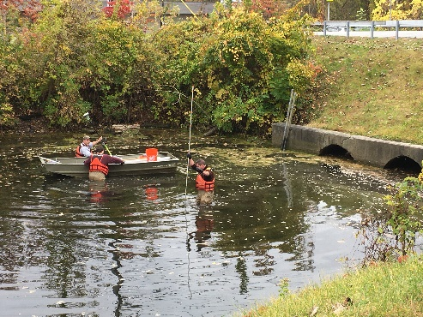
PROJECT #3 | Connect Olde Canalway to Turning Basin
New York Forward | Village of Schuylerville
Transform DOT Emergency Repair into Investment in Recreational Amenity
One of two culverts that run from the Olde Champlain Canal under Ferry Street to Schuylerville’s Turning Basin is failing.
In September, DOT officials notified Village officials that an emergency repair will be done to this one culvert.
NYS DOT estimates this repair might cost $1 million, and it’s scheduled for Spring 2023.
The Village is requesting $1 million so that NYS DOT can instead install a box culvert which would allow water level management in the Olde Canal, and people in kayaks and canoes to travel under Ferry Street from the Canal to the Turning Basin.
Community Impact
The Vision for the Olde Champlain Canal is that it will become a 1.5-mile recreational amenity on which people can kayak, canoe, and paddleboard, along the Empire State Trail. With the ability to manage the water level, it’s possible that the water will freeze for public skating in the winter as they do on many canals in Canada.
Total Project Cost: $2 million
NYF Requested Amount: $1 million
Site Control Status: DOT Owned
Additional Funds Identified: DOT Planned Emergency Repair
Project Timeline: Spring 2023

Slide 6
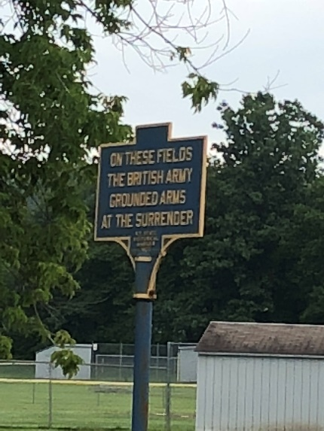
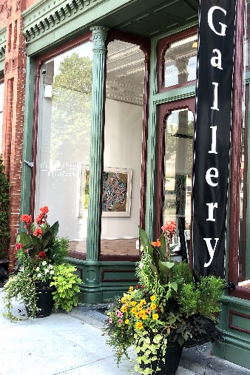
PROJECT #4 | Wayfinding and Walkability
New York Forward | Village of Schuylerville
Connecting Visitor Assets with Village Business District
NYS DOT invested $250,000 to modernize the Ferry-Broad Street intersection, and NYS has now installed signage to direct cyclists and others using the Empire State Trail which travels through Schuylerville. Here’s what’s missing:
The Village is spending $100,000 to upgrade sidewalks on Broad Street, but not Ferry St.
There is no wayfinding system to direct EST users into the Village and to promote the business district.
Historic signage to help educate and inform all visitors needs to be fixed and painted.
Total Project Cost: $325,000
NYF Requested Amount: $225,000
Site Control Status: Village and NYS DOT control public ways.
Additional Funds Identified: $100,000 budgeted for Village sidewalk improvements
Project Timeline: Sidewalks start in fall of 2022, but wayfinding and Ferry St. sidewalks can be spring 2023.
Community Impact
The Empire State Trail runs through the Village, but new sidewalks and better wayfinding systems will better connect visitors with local business, historic and recreational attractions.

Slide 7
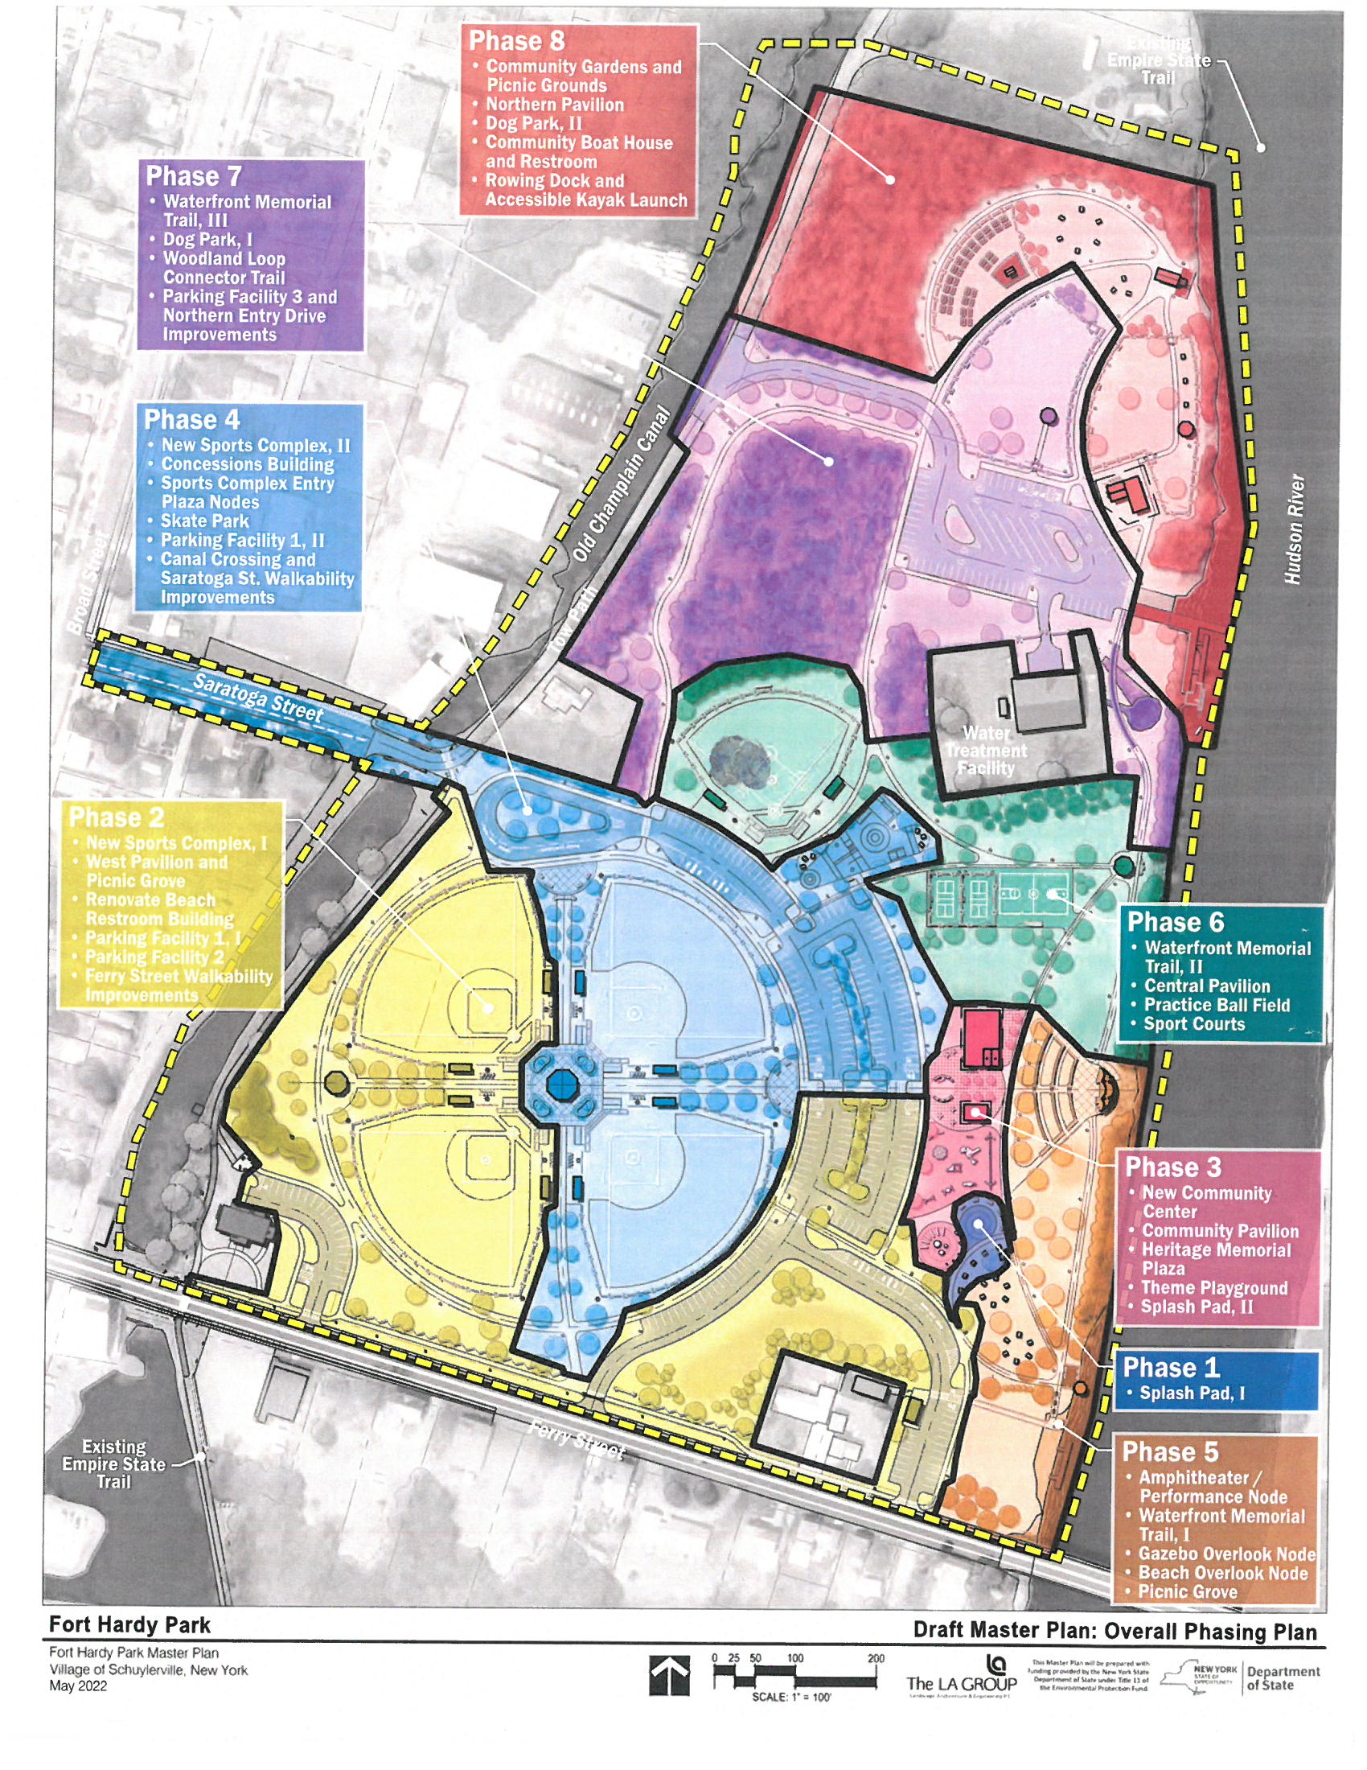
PROJECT #5 | FORT HARDY PARK
New York Forward | Village of Schuylerville
Community Center, Pavilion, and Amphitheater
The LA Group has devised a multi-phase Master Plan for the Fort Hardy Park. The total project cost is estimated to be $19.9 million. But this plan cannot reach out for additional funding until a pre-phase parkwide development plan is completed at a cost of $104,000. This pre-development plan includes:
Topographical survey.
Geotechnical and archeological investigations.
Development of a Cultural Resources Management Plan, plus permitting, and SEQR.
Total Project Cost: $104,000
NYF Requested Amount: $91,000
Site Control Status: Village owned
Additional Funds Identified: Village to fund balance of $13,000
Project Timeline: Start pre-phase permitting as soon as funds are allocated.

Slide 8
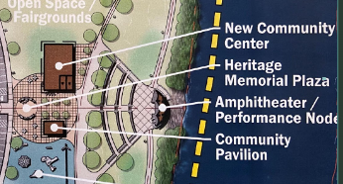
PROJECT #5 CONT. | FORT HARDY PARK
New York Forward | Village of Schuylerville
Community Center, Pavilion, and Amphitheater
The construction of a new community center project was a priority project identified in the Fort Hardy Park Master Plan completed in 2022 with funds from a NYSDOS grant.
The project represents the Village’s commitment to the public for a multigenerational destination hub that meet’s the community’s needs for social, educational, and recreational activities.
Host the existing Park’s Youth Program and provide an opportunity for other special interest and social groups to find a place for meetings and programs.
The project includes the adjacent Heritage Memorial Plaza, a central interpretive space that pays homage to the American Revolution.
Community Impact
This project is needed to attract new residents and retain existing residents by continuing to provide recreation opportunities. Recreation is essential for the well-being of all residents in the village of Schuylerville, including children, teens, adults, and seniors. Fort Hardy Park improvements are necessary to continue to provide Schuylerville families with resources that families in other nearby municipalities already have.
Total Project Cost: $1,685,000
NYF Requested Amount: $1,485,000
Site Control Status: Village owned.
Additional Funds Identified: Village to fund balance of $200,000
Project Timeline: Completed by fall of 2025

